Slide 1

Streamlining Community Service Process at FIU 1.0
Team Members: Ekaterina Gumnova and Kathryn Bello Product Owner: Allen Varela
Instructor: Masoud Sadjadi School of Computing and Information Sciences Florida International University
Final Presentation
Summer 2017
Notes:
7 seconds.( I will select 2 best slides (i will give them extra points and students will present for CIS committee)
Greet your audience, thank them for attending your presentation, introduce yourself, introduce your project, introduce your team members, and quickly indicate what each of you did in a high-level manner, and put more emphasis on your part/contribution.

Slide 2
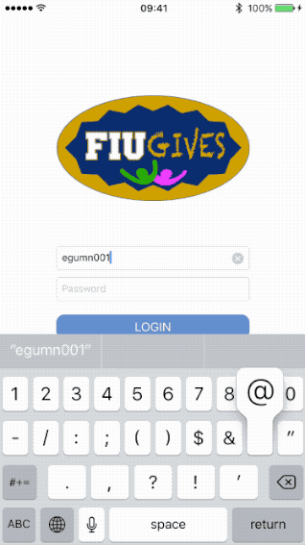
Project definition
Product owners requested a more efficient way to find and keep track of community service events available to Honors College students.
This mission was expanded to members outside of the FIU community because there is no centralized place to view volunteering events.
Current mobile applications for volunteering are not intuitive for users.
These applications do not have standardized requirements for event registration.
Notes:
10 seconds.
Introduce the problem that the whole project (in all versions) tackles with GIF or screenshot.

Slide 3
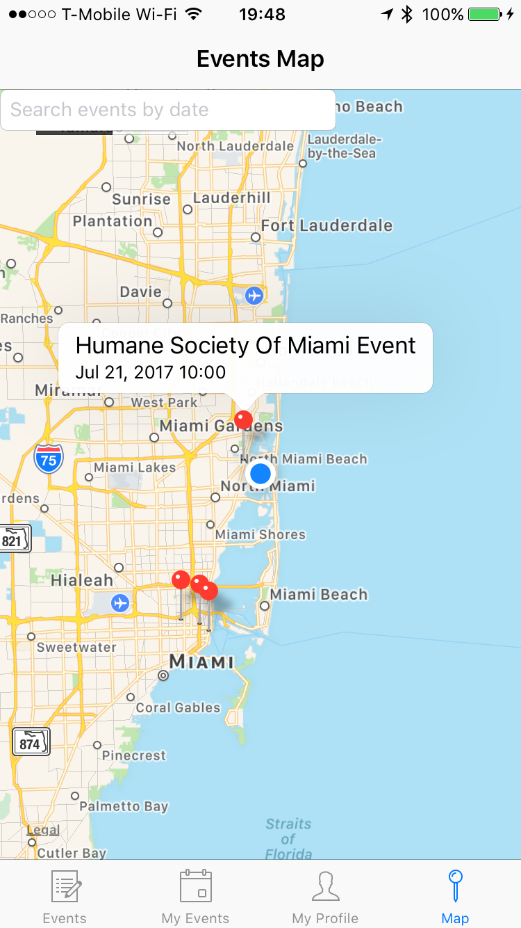
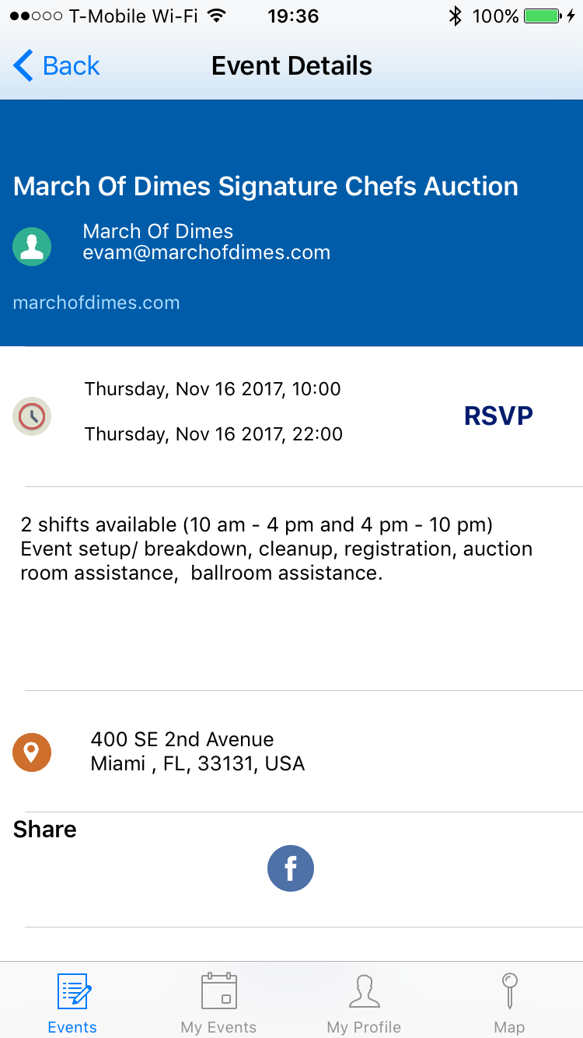
Project definition
Our proposed solution is a mobile application that streamlines the community service search and rsvp process.
This application allows users to create, view, filter, locate, and rsvp to volunteering events by combining the functionality of an event scheduler, calendar, and map.
Notes:
20 seconds.
Introduce the problem that the your project (in new version) tackles with GIF or screenshot.

Slide 4
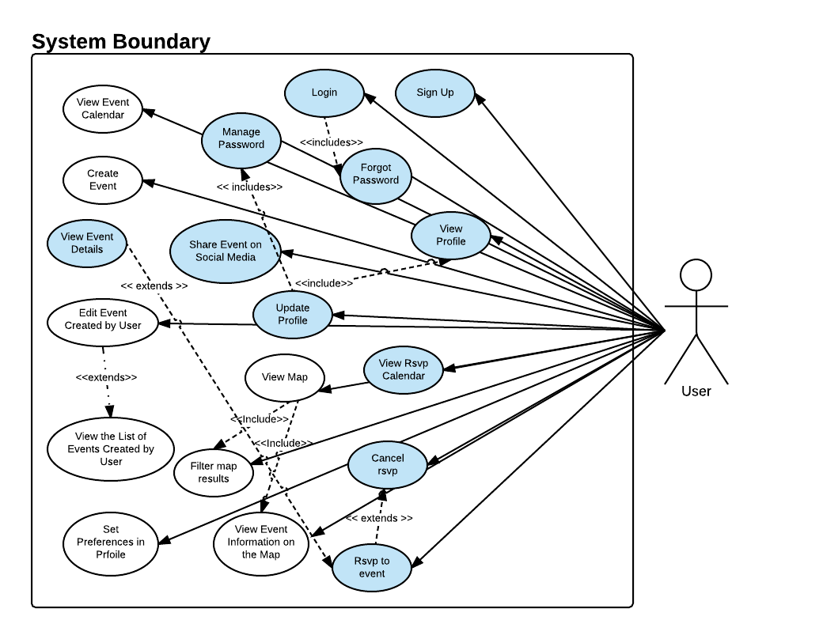
Requirements: Use Cases
Notes:
5 seconds
Show the Use Case Diagram for the whole project. Highlight your use cases.

Slide 5
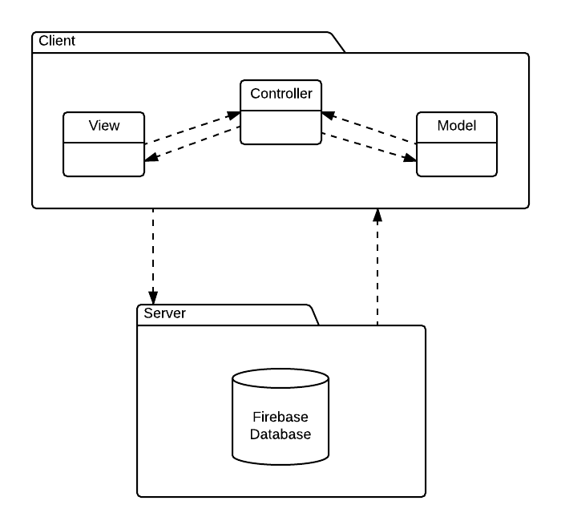
System Design: Architecture
Client-server architecture with MVC pattern for structuring the user interface. The communication between the views and the data is provided by the controller classes.
iPhone 5 and later with iOS 10.3.2
Notes:
20 seconds
System design: Highlight the parts that you contributed to them.
1. System decomposition; identify the architecture patterns used
2. System deployment – h/w and s/w requirements

Slide 6
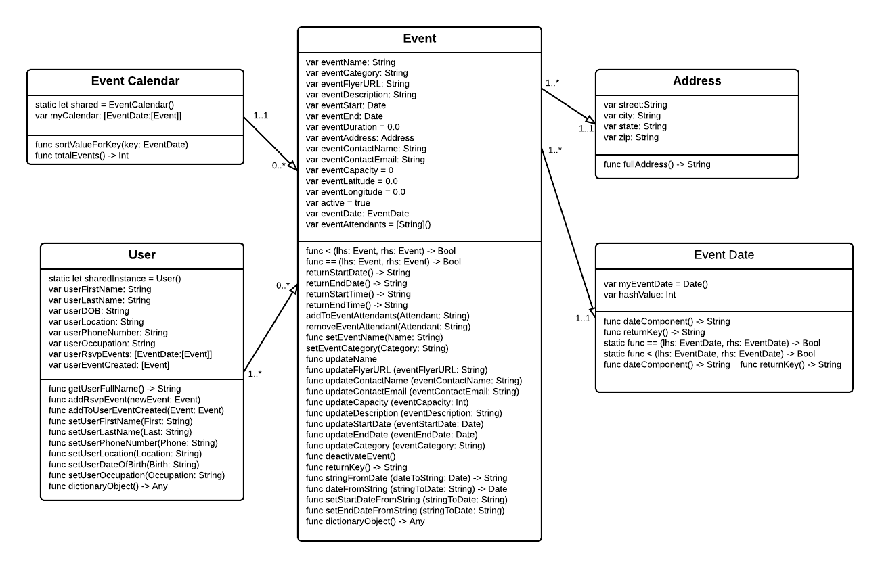
Minimal Class Diagram
Minimal diagram of the model classes in the system. Implemented singleton pattern for user and event calendar classes, as only one instance of each is required for the process.
Notes:
10 seconds.Minimal class diagram. Highlight the classes that you created/modified
Identify the design patterns used (one or more slides).

Slide 7
User Stories
667 - Create Event
668 - View Event Calendar
670 - View Event Details
671 - Rsvp to Event
672 - View Rsvp Calendar
677 - View Map
674 - Filter Map Results
665 - Set Preferences in Profile
676 - Sign up
679 - View List of Events Created by User
Notes:
5 seconds.
List the user stories that you worked on them.(put in order of importance). Stay focused on the parts that you have been working.

Slide 8
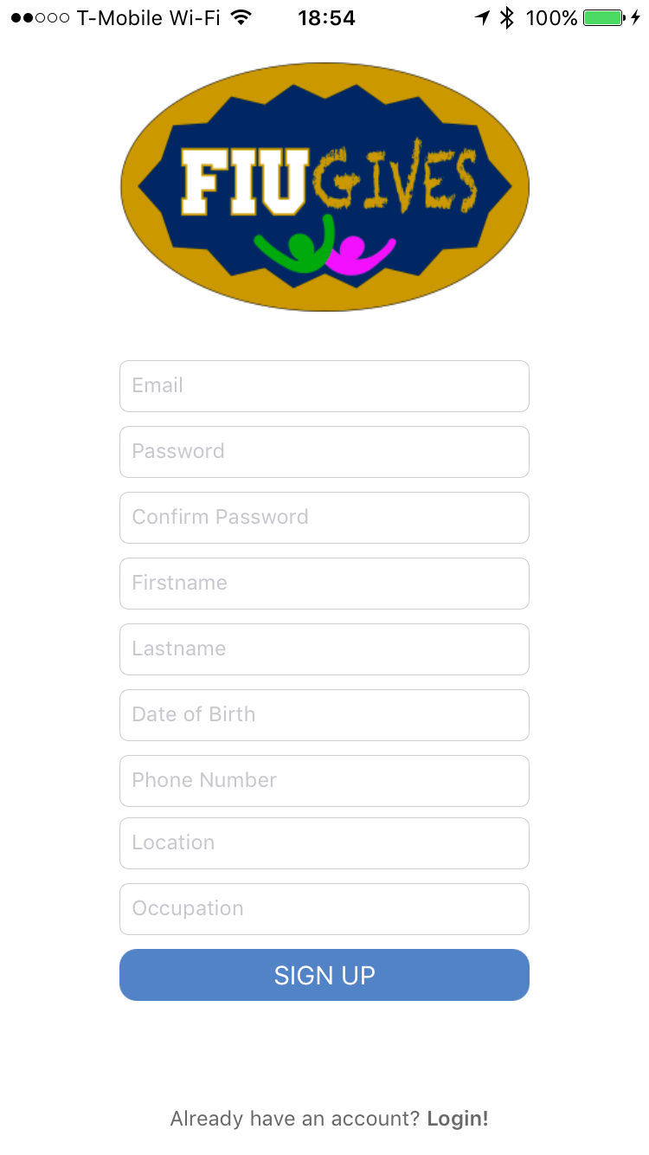
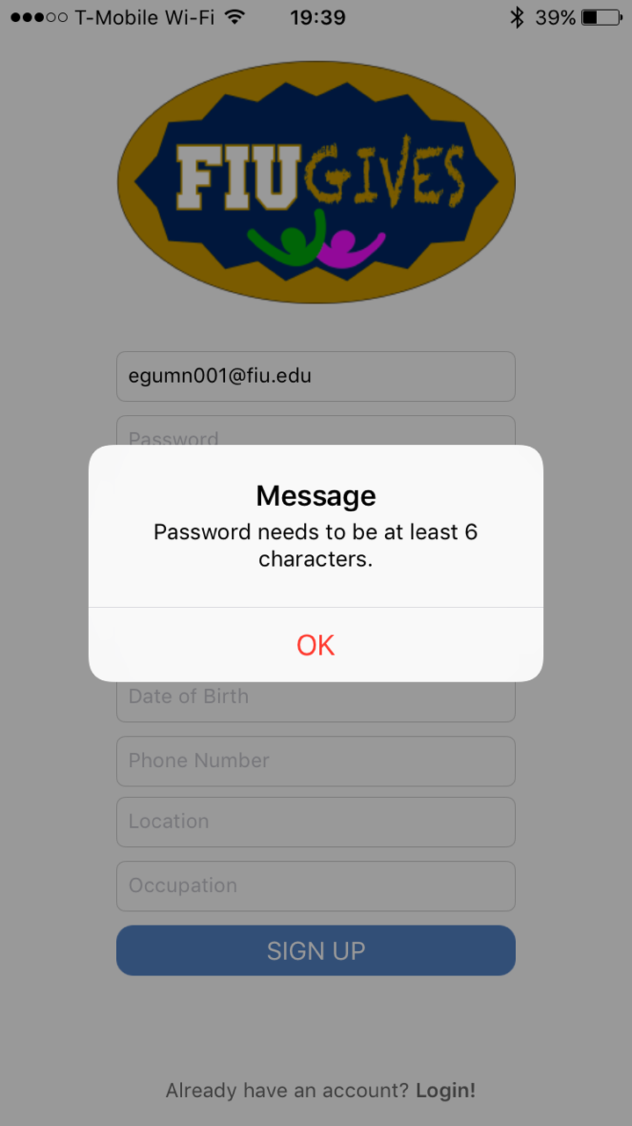
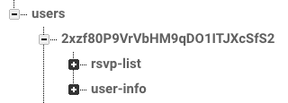
User Story 676 - Sign up
As a user, I would like to sign up so that I can use the software securely and my data isn’t viewed by unregistered users.
Acceptance Criteria:
The system should offer the user the option to login (Login button).
The system must validate the text input by the user.
The user should be logged in automatically after sign up.
Users tree structure in Firebase.

Slide 9
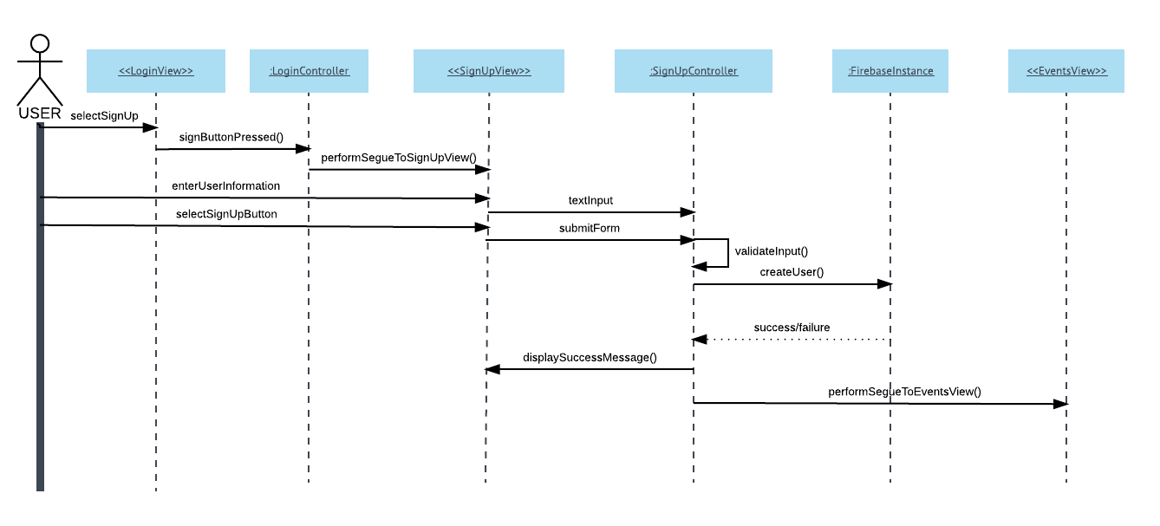
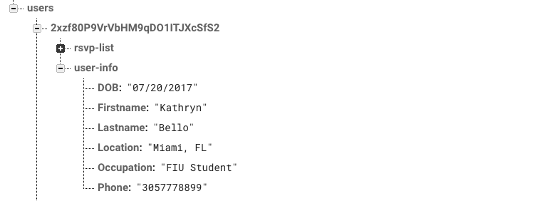
User Story 676 - Sign up
Users tree structure in Firebase with node for user-info (created after sign up) and rsvp-list.

Slide 10
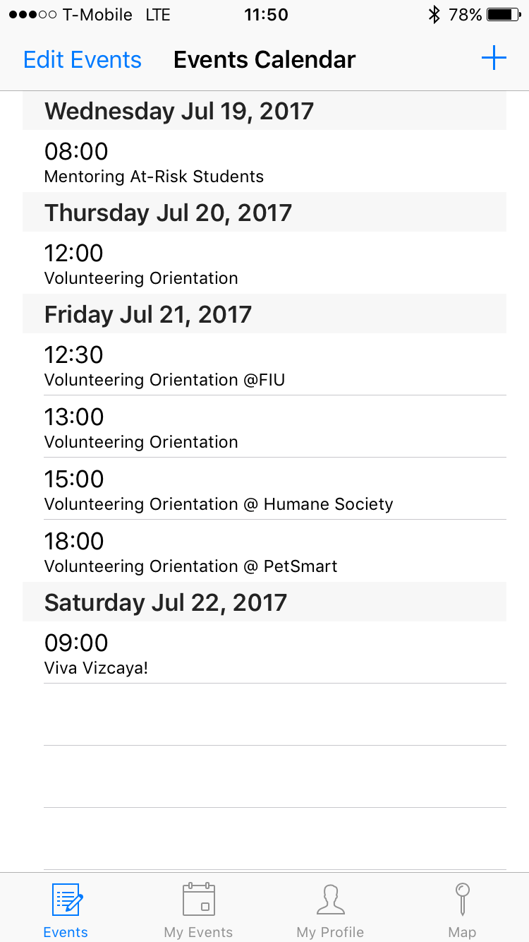
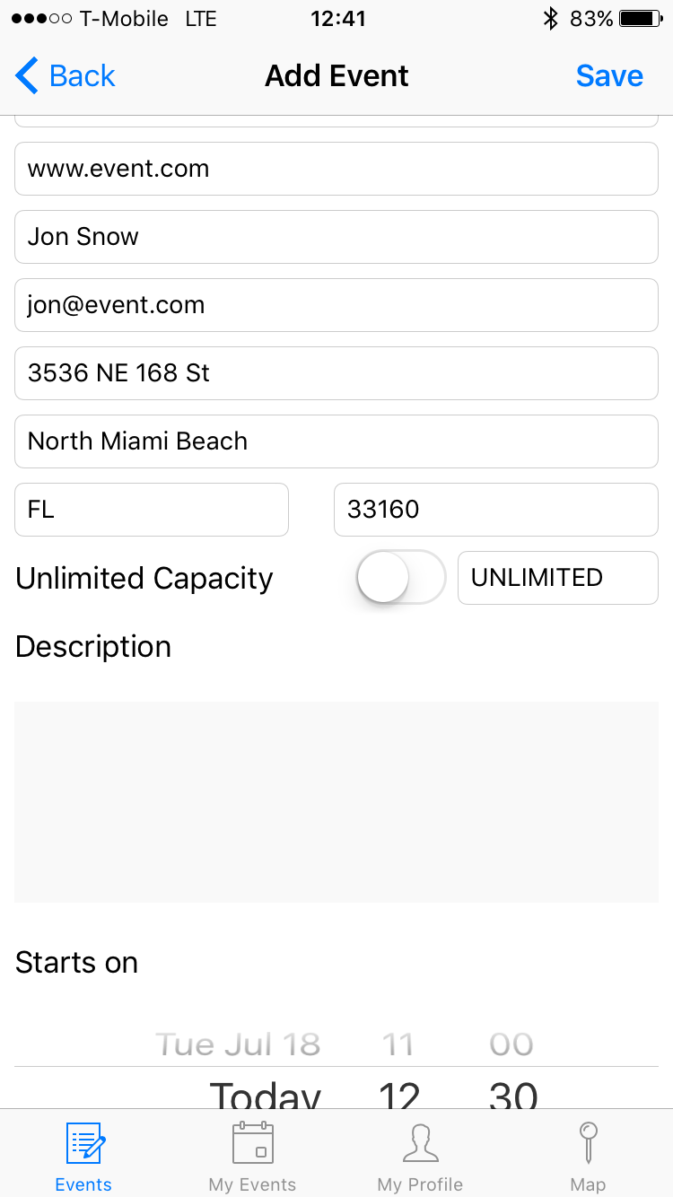
User Story 667 - Create Event
Create Event - As a user, I would like to be able to create a volunteering event so that it is added to the events network and displayed in the events calendar.
Acceptance Criteria:
A User should be able to click “+” button and see the form to add event details.
A User should be able to click “Back” at any time to cancel the use case.
A User should be able to see and click on any of the buttons on the tab bar.
All fields for event details should contain placeholders to guide the User what information is expected.
Notes:
60 seconds
The tile of user story
The most important user story you worked on it. You have to describe this one very well and be proud of that.
Please present and show the complexity of your work, code, algorithms, and technical challenges and technologies you have used. (you could use screenshot if you want. Visual presentations are better than text presentation)
Go into the details of the most important/significant tasks using bullet lists or visual graphs or state chart diagram
Sequence Diagram for this user story is mandatory (in another separate page if required)
Demo using screenshots or GIF (in another separate page if required)

Slide 11
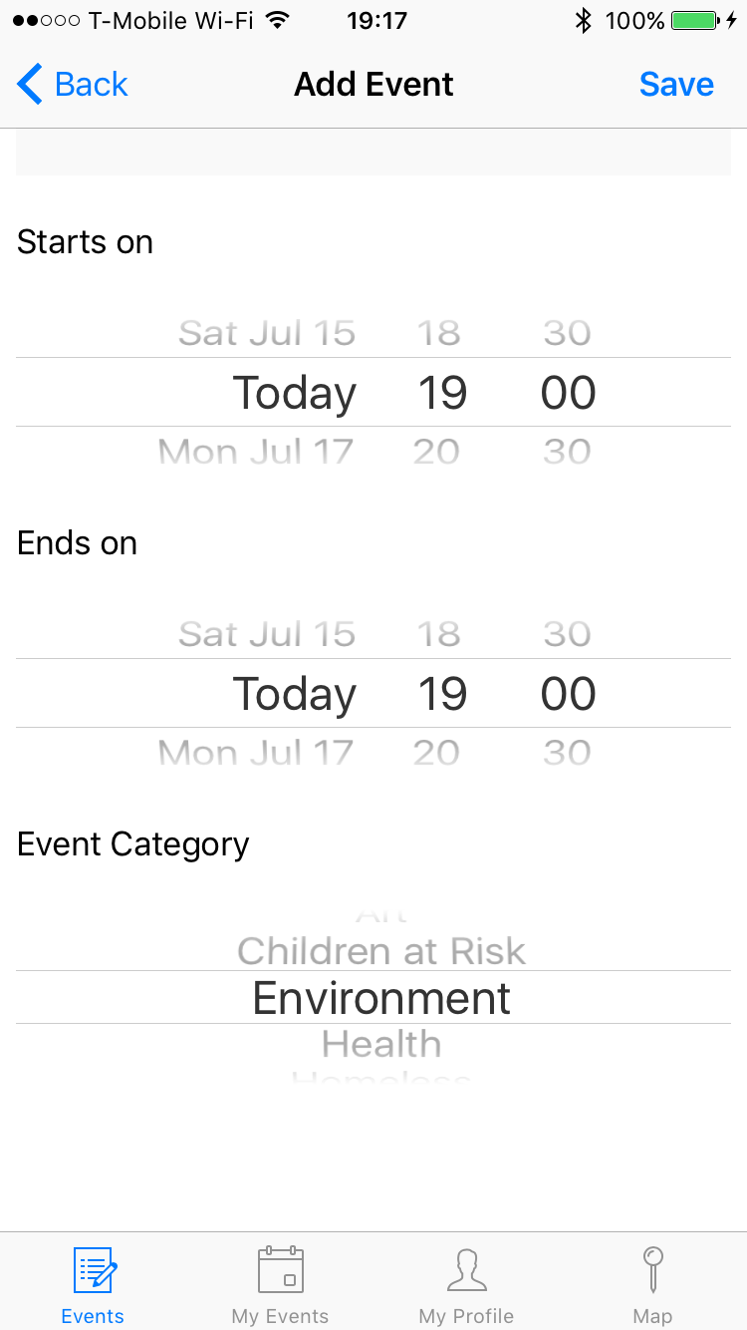
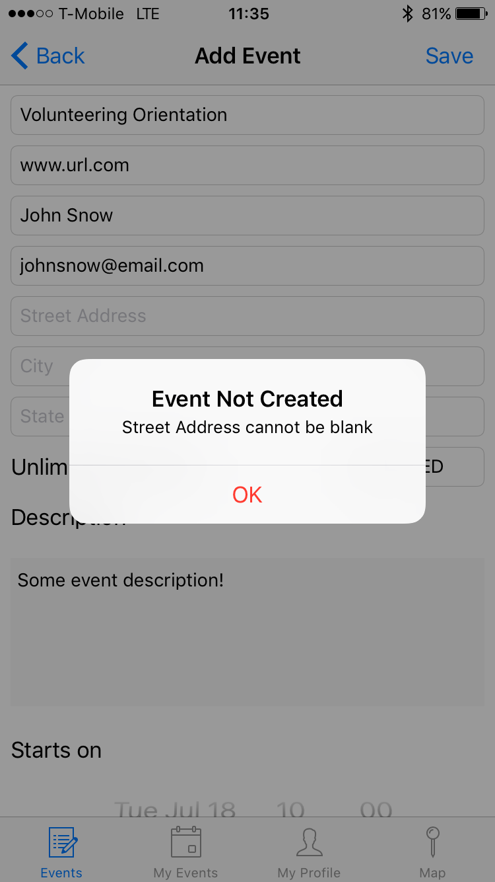
User Story 667 - Create Event (cont’d)
A user should be able to select the start and end time of the event using the date picker and the end date cannot precede the start date.
A user should be able to see all options available to categorize an event in the event category picker.
A user should receive an alert if any of the fields are left blank specifying which field to complete.
Notes:
60 seconds
The tile of user story
The most important user story you worked on it. You have to describe this one very well and be proud of that.
Please present and show the complexity of your work, code, algorithms, and technical challenges and technologies you have used. (you could use screenshot if you want. Visual presentations are better than text presentation)
Go into the details of the most important/significant tasks using bullet lists or visual graphs or state chart diagram
Sequence Diagram for this user story is mandatory (in another separate page if required)
Demo using screenshots or GIF (in another separate page if required)

Slide 12
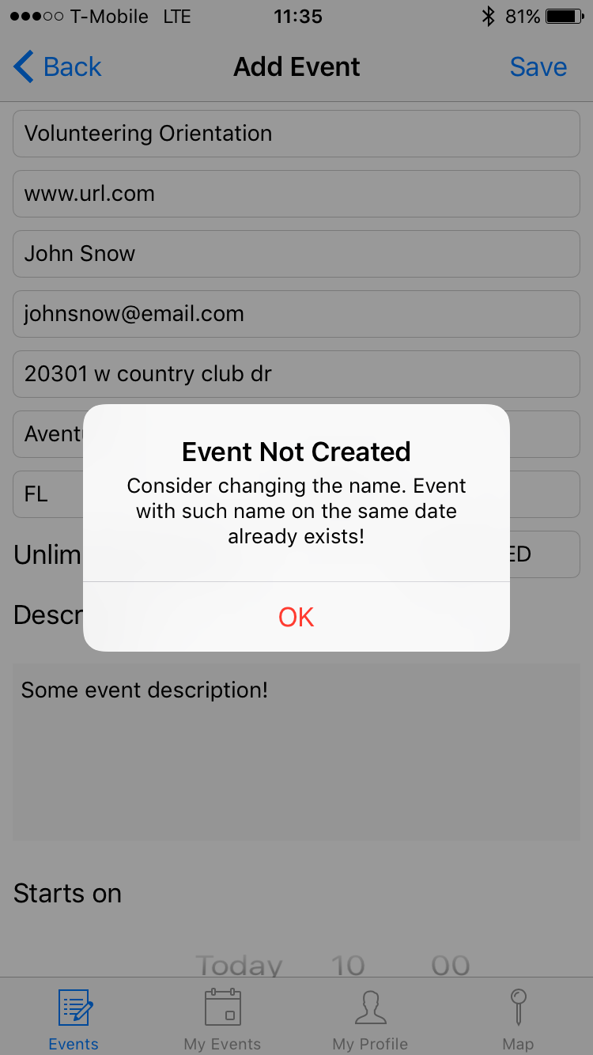
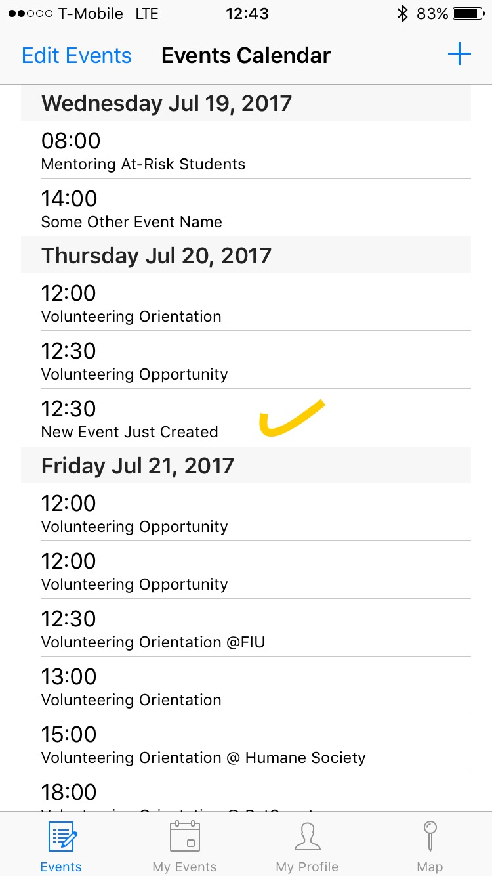
User Story 667 - Create Event (cont’d)
A user should be able to click “Save” button in order to add the event to the calendar.
A user should be notified if an event with the same date and on the same date is already added to the calendar.
A user should be able to see the event in the event calendar once the event creation is completed.
Notes:
60 seconds
The tile of user story
The most important user story you worked on it. You have to describe this one very well and be proud of that.
Please present and show the complexity of your work, code, algorithms, and technical challenges and technologies you have used. (you could use screenshot if you want. Visual presentations are better than text presentation)
Go into the details of the most important/significant tasks using bullet lists or visual graphs or state chart diagram
Sequence Diagram for this user story is mandatory (in another separate page if required)
Demo using screenshots or GIF (in another separate page if required)

Slide 13
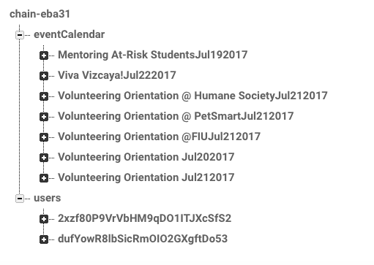
Events calendar tree structure in Firebase

Slide 14
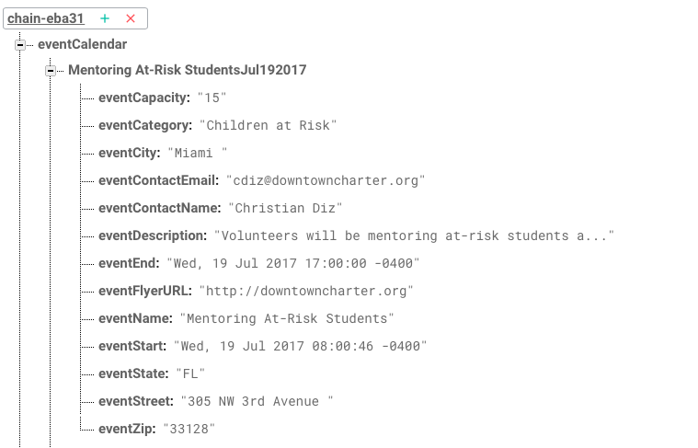
Event details tree structure in Firebase

Slide 15
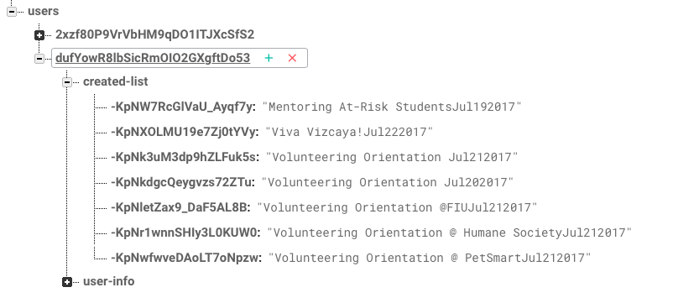
Users tree structure in Firebase

Slide 16
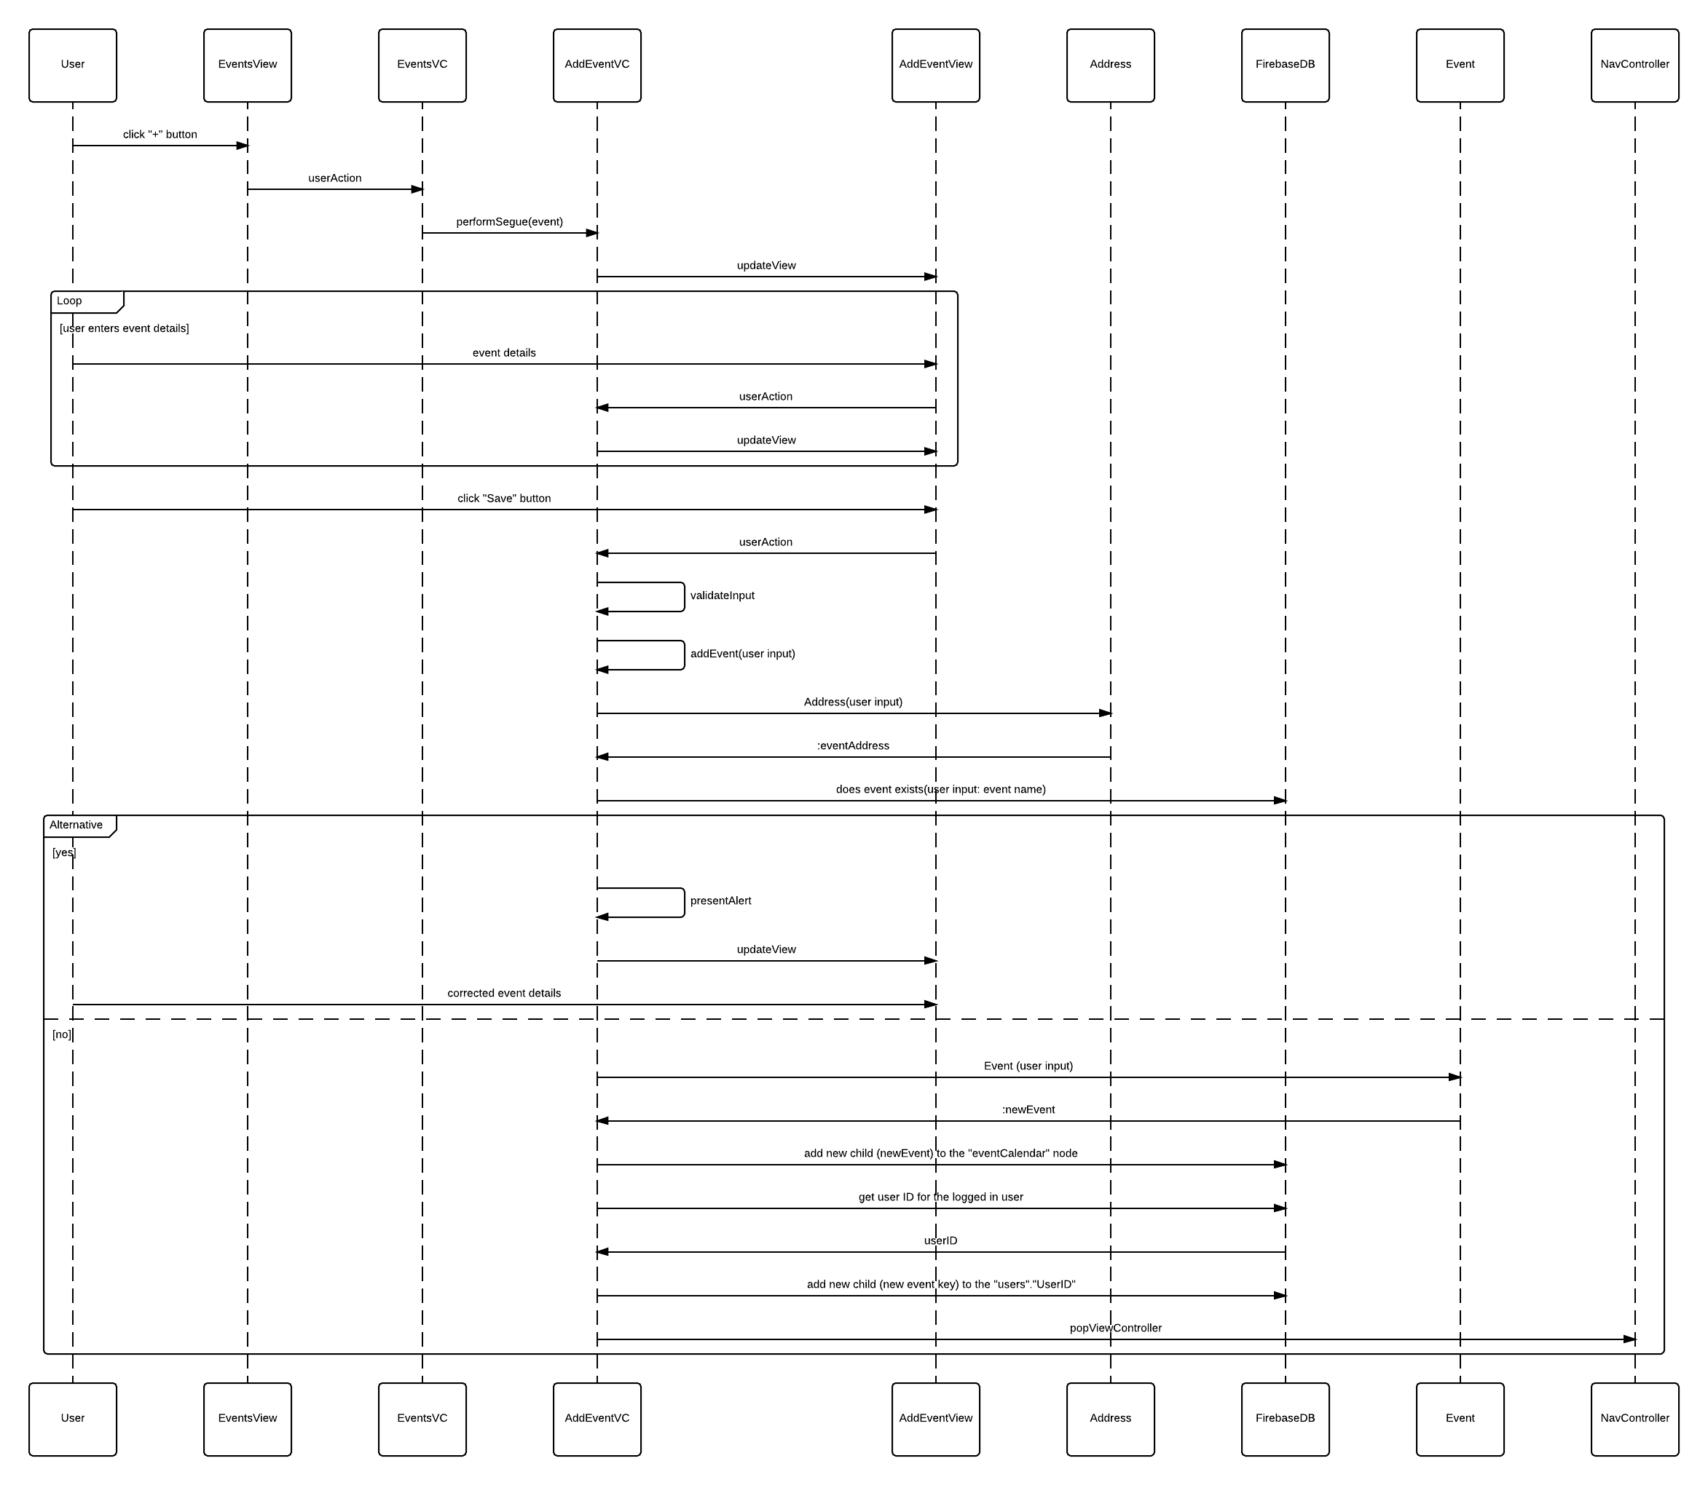
ADD EVENT

Slide 17
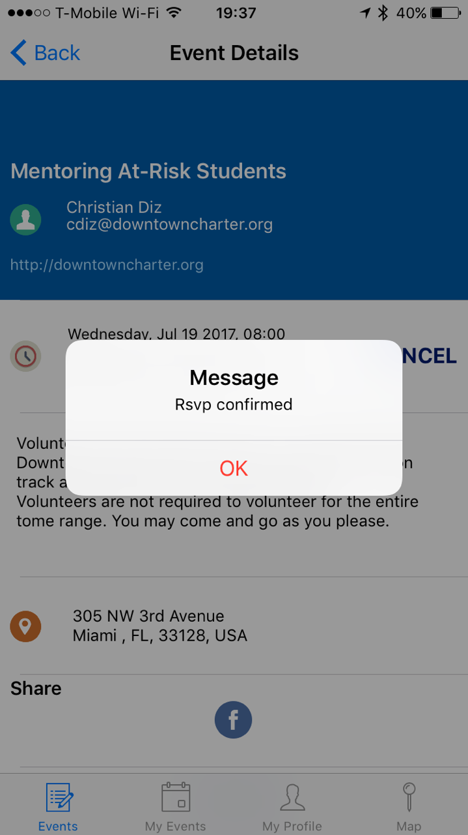
User Story 670/671 - View Event Details/Rsvp to Event
670 - As a user, I would like to view event details so that I can see if I am interested in that event.
All event information should be displayed.
There should be an Rsvp button (User Story 671).
There should be a button for sharing on Facebook (User Story 675).
671 - As a user, I would like to Rsvp to an event so that I can keep track of my volunteering activities.
The user should receive a confirmation message when the button is selected.
When the Rsvp button is selected, it should be updated to a Cancel button.
The system should prompt the user for calendar access after Rsvp is selected (Adds event to user’s telephone’s calendar).
Notes:
20 seconds
The tile of user story
Please present and show the complexity of your work, code, algorithms, and technical challenges and technologies you have used. (you could use screenshot if you want. Visual presentations are better than text presentation) - Go into the details of the most important/significant tasks using bullet lists or visual graphs or state chart diagram - Demo using screenshots or GIF (in another separate page if required)
Sequence Diagram for this user story is optional

Slide 18
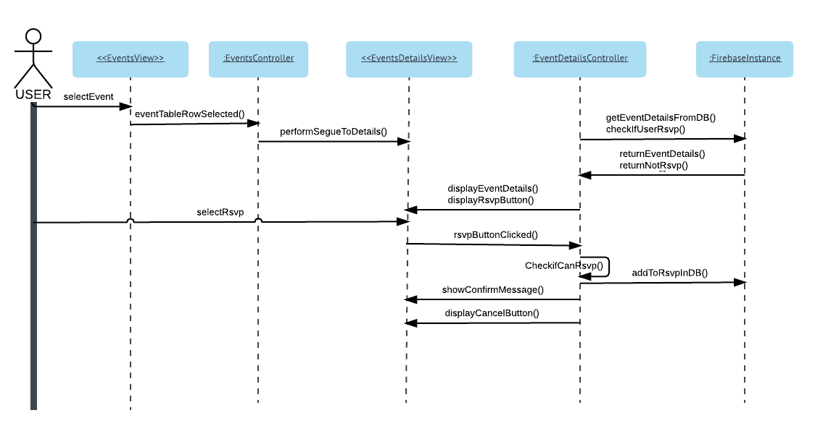
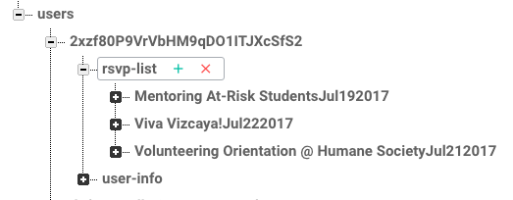
User Story 670/671 - View Event Details/Rsvp to Event
Users tree structure in Firebase with node for rsvp-list.

Slide 19
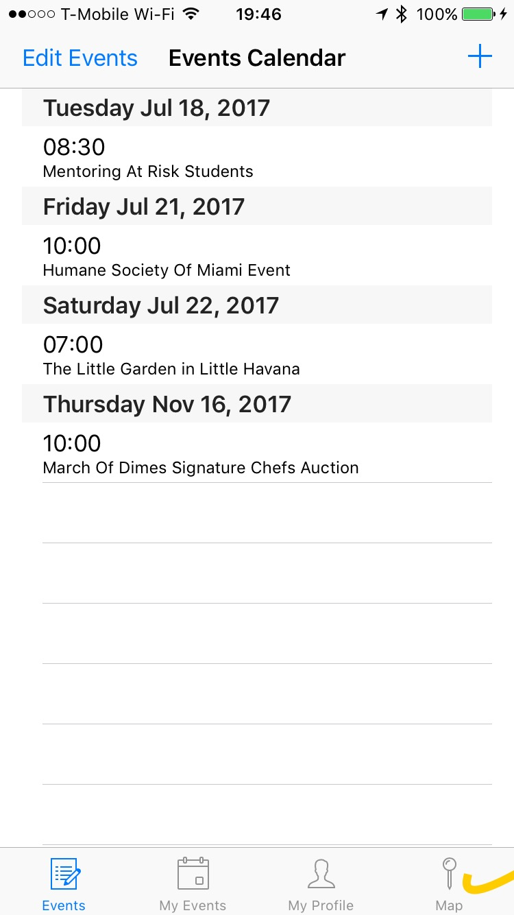
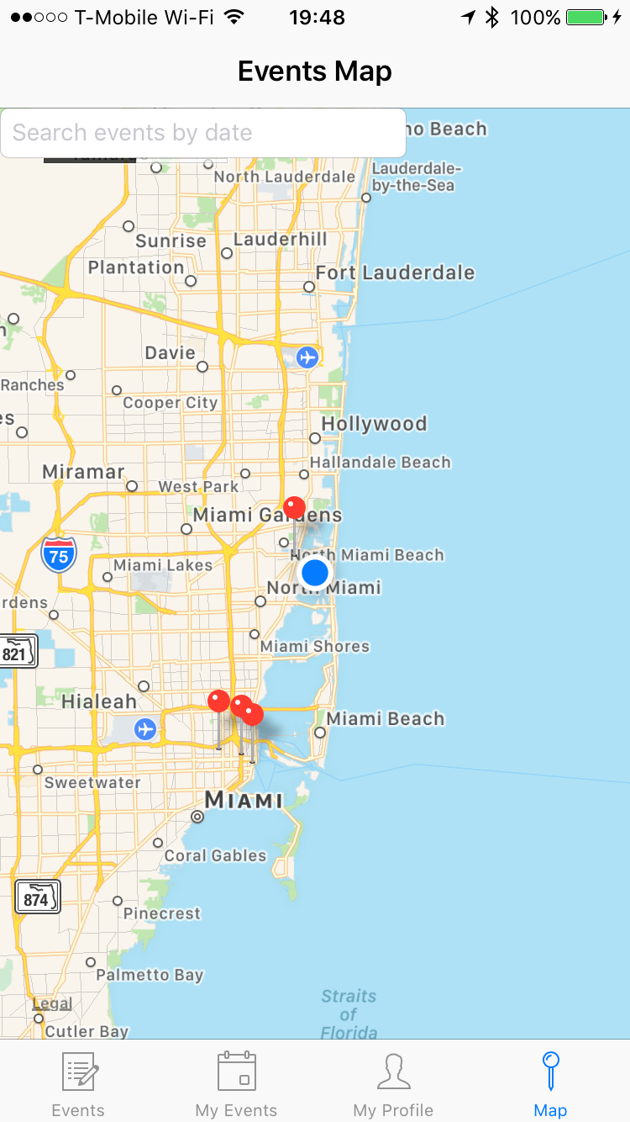
User Story 677/673/674 - View Map/Event Info/Filter Map Results
Create Event - As a user, I would like to be able to view a map that pins all the events on the map and shows event name and date when I click on the pin so that I can see their location relative to my current location.
Acceptance Criteria:
A User should be able to click Map button at the bottom bar at any moment in the application run and view the map centered at his current location with all the event locations pinned to the map.
A User should see a search bar on top of the screen to be able to select a date and only display events that occur on a that date.
Notes:
60 seconds
The tile of user story
The most important user story you worked on it. You have to describe this one very well and be proud of that.
Please present and show the complexity of your work, code, algorithms, and technical challenges and technologies you have used. (you could use screenshot if you want. Visual presentations are better than text presentation)
Go into the details of the most important/significant tasks using bullet lists or visual graphs or state chart diagram
Sequence Diagram for this user story is mandatory (in another separate page if required)
Demo using screenshots or GIF (in another separate page if required)

Slide 20
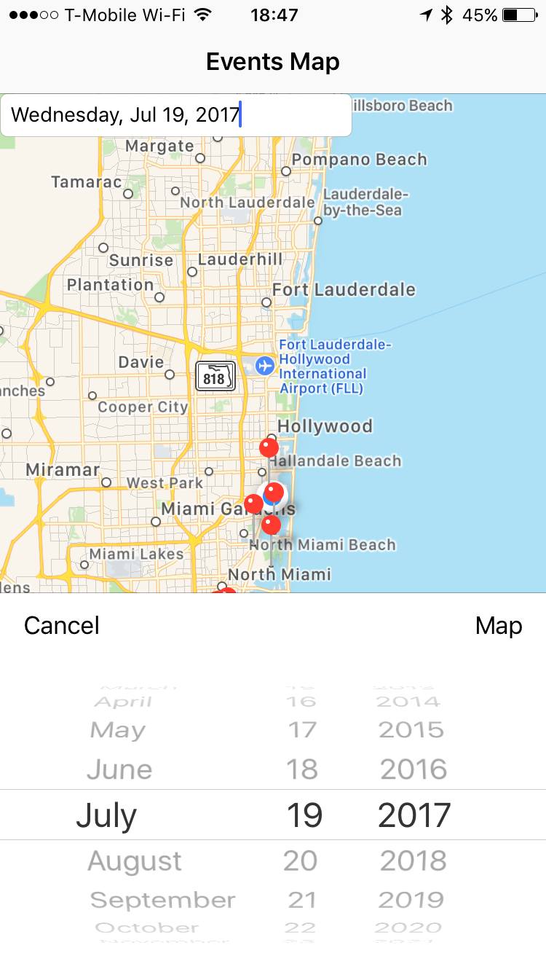
User Story 677/673/674 - View Map/Event Info/Filter Map Results (Contin’d)
Acceptance Criteria:
A User should be able to click on the pin and see event name and date.
When a user clicks on the search bar he should see a date picker that allows him to select a date.
When a user picks a date and clicks “Map” button he should see only events for that date pinned on the map.
A User should be able to dismiss the date picker by clicking the “Cancel” button.
Notes:
60 seconds
The tile of user story
The most important user story you worked on it. You have to describe this one very well and be proud of that.
Please present and show the complexity of your work, code, algorithms, and technical challenges and technologies you have used. (you could use screenshot if you want. Visual presentations are better than text presentation)
Go into the details of the most important/significant tasks using bullet lists or visual graphs or state chart diagram
Sequence Diagram for this user story is mandatory (in another separate page if required)
Demo using screenshots or GIF (in another separate page if required)

Slide 21
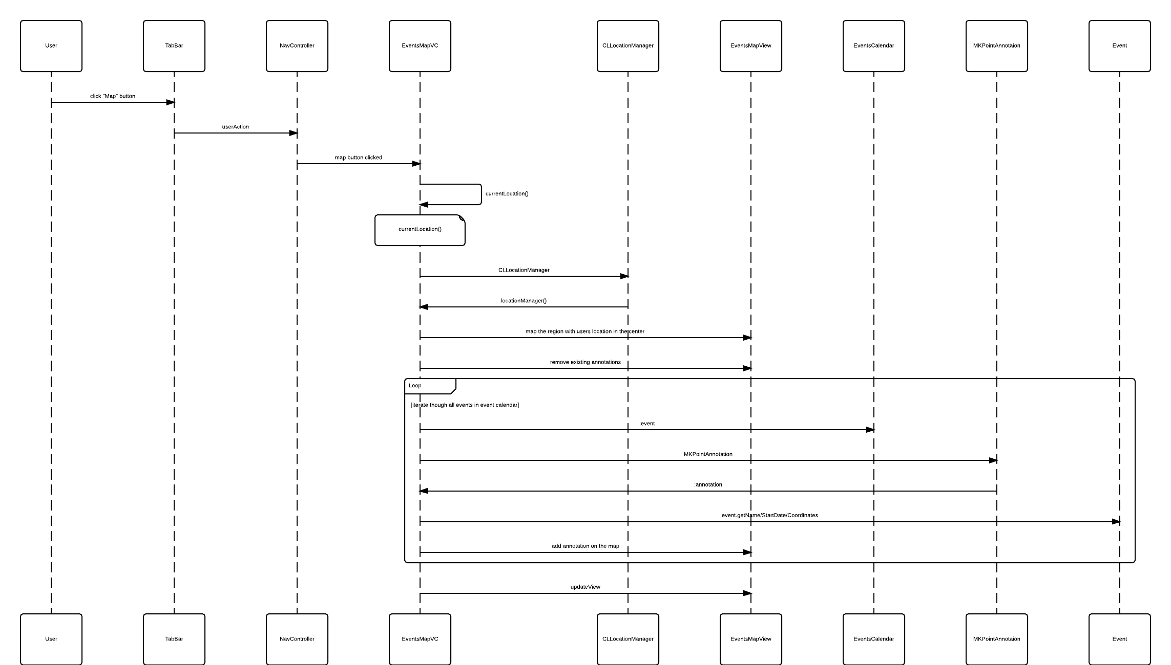
VIEW EVENT MAP

Slide 22
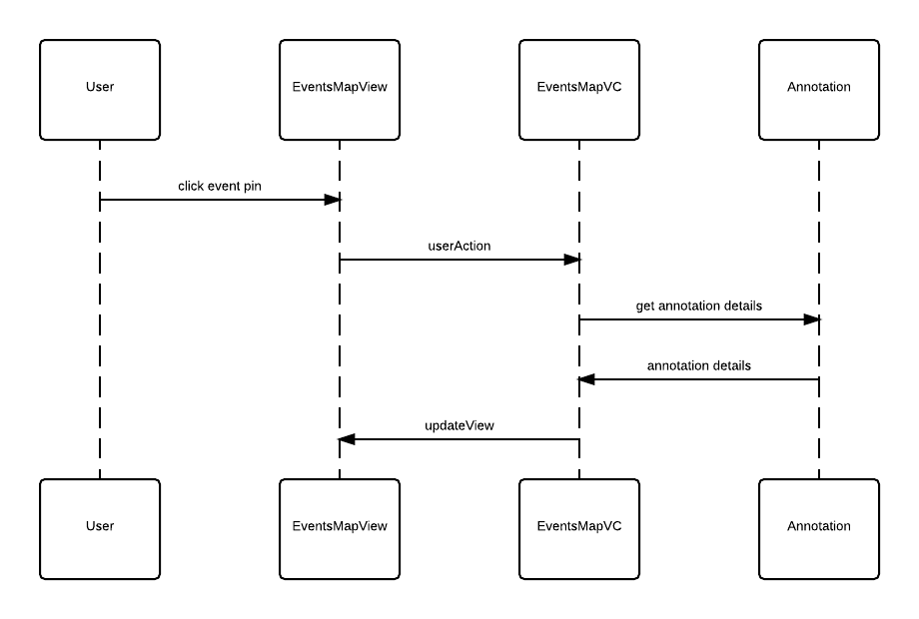
VIEW EVENT DETAILS ON THE MAP (invoked from the VIEW MAP)

Slide 23
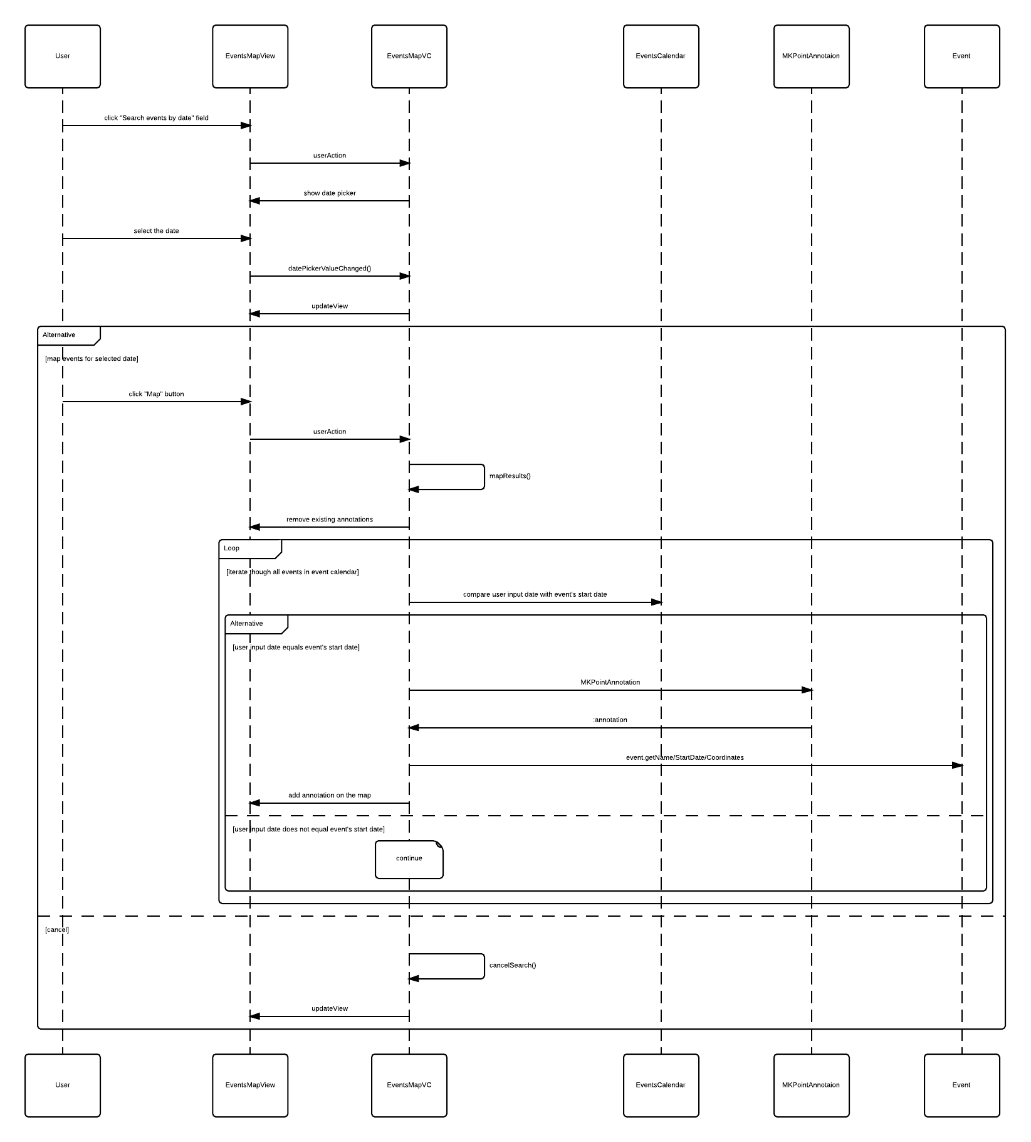
FILTER MAP RESULTS ON THE MAP (invoked from the VIEW MAP)

Slide 24
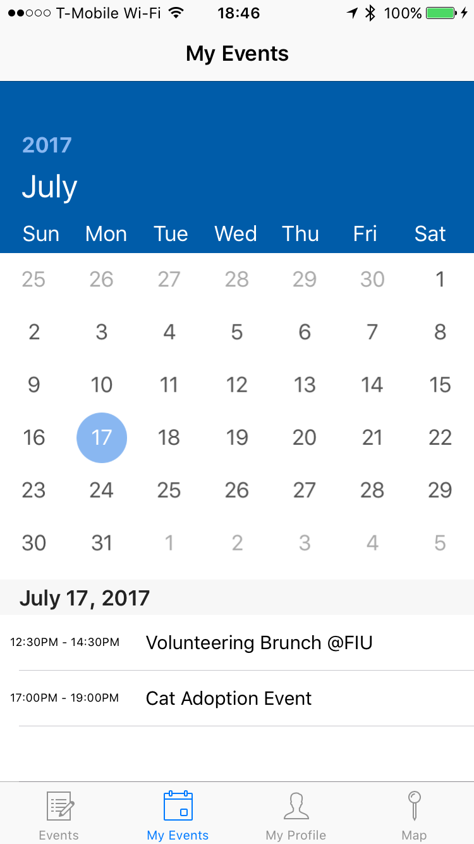
User Story 672 - View Rsvp Calendar
As a user, I would like to view a calendar of volunteer events that I Rsvp’d to so that I can manage and organize my time.
Acceptance Criteria:
When the calendar loads, the cell selected should be the current date.
Rsvp’d events should be displayed in a list in chronological order whenever a calendar cell is selected.
Clicking an event in the list should direct the user to the corresponding event’s details.
Each event in the list should have name and time information.
Notes:
20 seconds
The tile of user story
Please present and show the complexity of your work, code, algorithms, and technical challenges and technologies you have used. (you could use screenshot if you want. Visual presentations are better than text presentation) - Go into the details of the most important/significant tasks using bullet lists or visual graphs or state chart diagram - Demo using screenshots or GIF (in another separate page if required)
Sequence Diagram for this user story is optional

Slide 25
Test Case: Verify that a New Event is Added to the Firebase and Displayed Correctly in the Events Calendar
Expected Result: new event’s key is nested under the eventCalendar node in the database with all of the child nodes: eventName, eventDescription, eventCategory, eventCapacity, eventContactName, eventContactEmail, eventFlyerURL, eventStart, eventEnd, eventStreet, eventCity, eventState, eventZip, which are stored with corresponding values.
Notes:
10 seconds
A description of verification process and Test Suites and Test Cases for one of the use cases.
1 One sunny day and one rainy day for the implemented use cases (one or more slides).
2 Automated test scripts for the implemented use cases (if any) (one or more slides).

Slide 26
Test Case: Verify that a New Event is Added to the Firebase and Displayed Correctly in the Events Calendar (continued)
Expected Result: input validation is performed, none of the fields are allowed to be left blank; an event cannot be added to the database if another event with the same name occurring on the same date exists in the database.

Slide 27
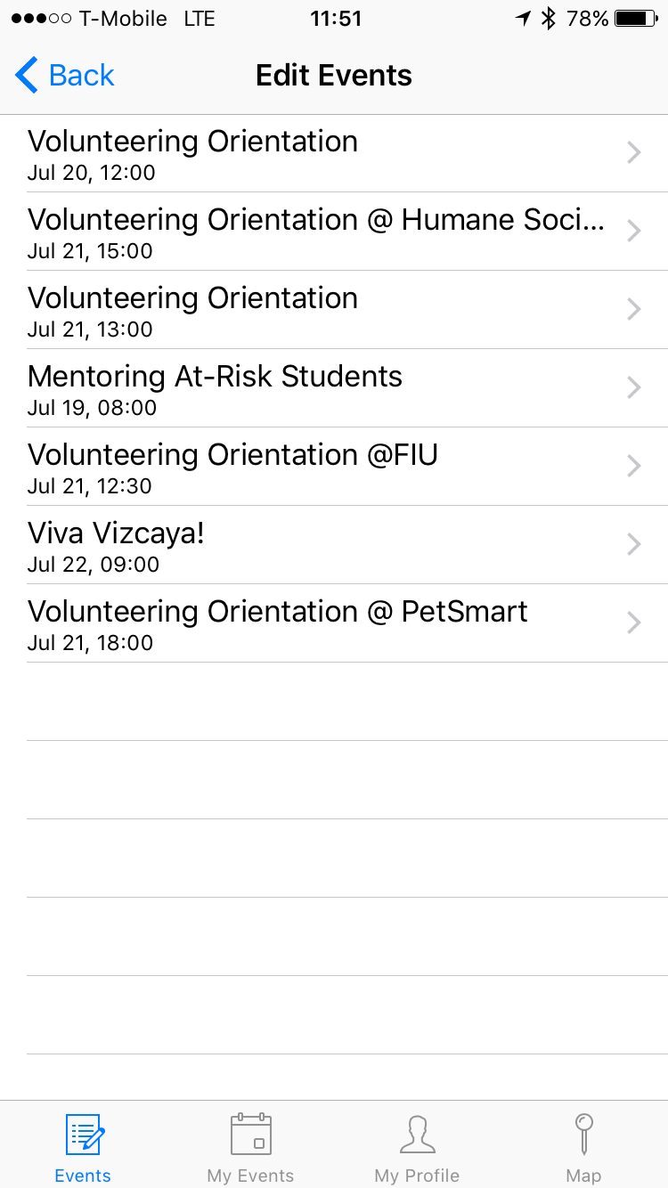
Test Case: Verify that a New Event is Added to the Firebase and Displayed Correctly in the Events Calendar (continued)
Expected Result: the added event shows under the Events Calendar and under the Edit Events.
func testEventInitializerFails() {
let emptyNameEvent = Event.init(eventName: "", eventCategory: "", eventFlyerURL: "", eventDescription: "", eventStart: NSDate(), eventEnd: NSDate(), eventLocationName: "Aventura hospital", eventClubs: "", eventContactName: "Allen", eventContactEmail: "allen@email", eventRSVPEnabled: true)
XCTAssertNil(emptyNameEvent)
}

Slide 28
Summary
Thus, the first prototype of Streamlining Community Service Process at FIU provides a simple and efficient solution to the product owner’s problem. We created a centralized and user friendly place for volunteering events.
This is the first version of the application. It includes the essential functionalities of the system but it can be expanded and improved into a social media platform to fully accomplish the owner's goal of engaging people in the community.

Slide 29





Thank you! Any Questions?
Kathryn Bello: kbell005@fiu.edu
Ekaterina Gumnova: egumn001@fiu.eud
Notes:
10 seconds
Summarize your contribution, mention your effort for Scrum, Mingle, Github, Google Drive Documentation and minutes
Include your contact information
Ask if anyone has any questions for you.
Thank your audience

